Slide 1
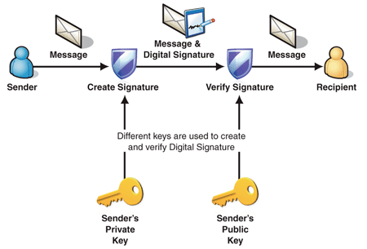
Digital Signatures
Public-key encryption provides a method for doing digital signatures
To sign a message, M, Alice just encrypts it with her private key, SA, creating C = E_{SA}(M).
Anyone can decrypt this message using Alice’s public key, as M’ = D_{PA}(C), and compare that to the message M.

Slide 2
Cryptographic Hash Functions
To reduce the size of the message that Bob has to sign, we often use cryptographic hash functions, which are checksums on messages that have some additional useful properties
A checksum on a message, M, that is:
One-way: it should be easy to compute Y=H(M), but hard to find M given only Y
Collision-resistant: it should be hard to find two messages, M and N, such that H(M)=H(N).
Examples: SHA-1, SHA-2 ( 224, 256, 384, 512)

Slide 3
Crypt. Hash Func. For MTM prevention & Integrity of critical files
Cryptographic hash function can reduce the time and space needed for bob to perform a digital signature by first having him hash the message M to produce h(M) and then have him sign this value (also called Digest of M).
S=E_{SB} (h(M))
Now to verify signature S on a message M, Alice computes h(M), which is easy and then check that
D_{PB} (S)= h(M)
Signing a cryptographic digest of the message not only is more efﬁcient than signing the message itself, but also defends against the man-in-the middle attack.
It can also be used to protect the integrity of critical files in an OS.

Slide 4
Message Authentication Codes
A cryptographic hash function h can be used in conjunction with a secret key shared by two parties to provide integrity protection to messages exchanged over an insecure channel
Suppose Alice and Bob share a secret key K
When Alice wants to send a message M to Bob, she computes the hash value of the key K concatenated with message M:
A = h(K||M).
This value A is called a message authentication code (MAC)
Alice then sends the pair (M,A) to Bob.
Since the communication channel is insecure, we denote with (M’,A’) the pair received by Bob.
Since Bob knows the secret K, he computes the authentication code for the received message M himself:
A’’ = h(K||M’).
If this computed MAC A’’ is equal to the received MAC A’, then Bob is assured that M’ is the message sent by Alice, i.e., A’’= A’ implies M’ = M

Slide 5

Message Authentication Codes
Communication channel
(attack detected) =?
h
6B34339
4C66809
4C66809
87F9024
h
message M
MAC
MAC
received MAC
computed MAC
message M’
shared
secret
key
shared
secret
key
Sender
Attacker
(modifying)
Recipient

Slide 6
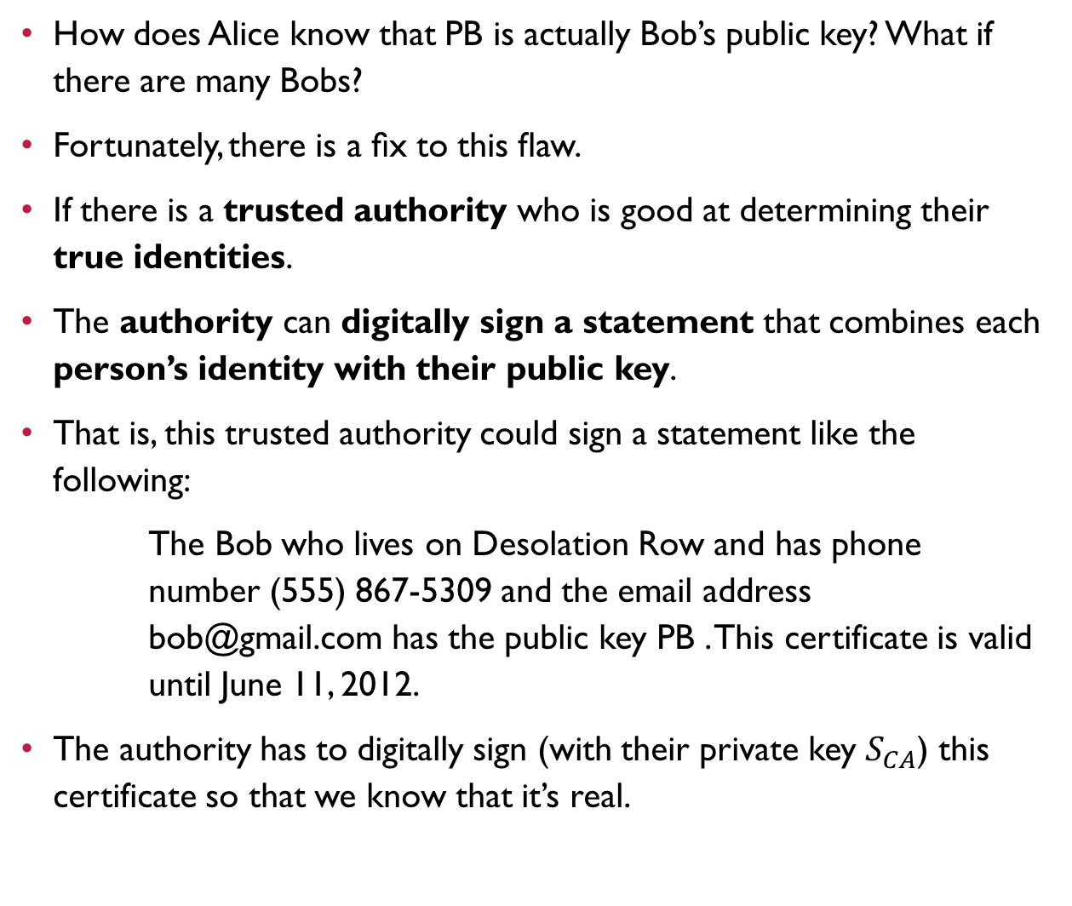
Digital Certificates
How does Alice know that PB is actually Bob’s public key? What if there are many Bobs?
Fortunately, there is a ﬁx to this ﬂaw.
If there is a trusted authority who is good at determining their true identities.
The authority can digitally sign a statement that combines each person’s identity with their public key.
That is, this trusted authority could sign a statement like the following:
The Bob who lives on Desolation Row and has phone number (555) 867-5309 and the email address bob@gmail.com has the public key PB . This certificate is valid until June 11, 2012.
The authority has to digitally sign (with their private key $S_{CA}$) this certificate so that we know that it’s real.

Slide 7
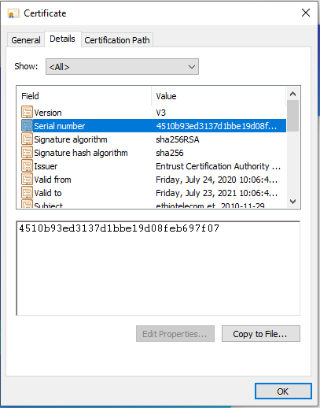
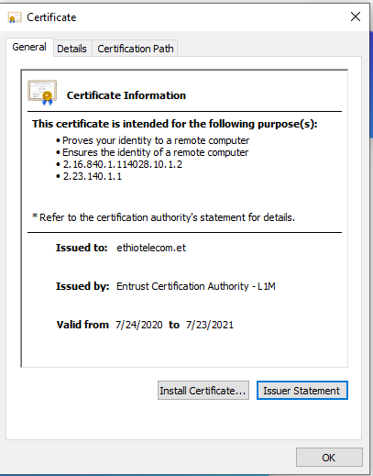
Digital Certificates
Such a statement is called a digital certiﬁcate so long as it combines a public key with identifying information about the subject who has that public key.
The trusted authority who issues such a certiﬁcate is called a certiﬁcate authority (CA).
The public keys of commonly accepted CAs come with the operating system.
Since the digital certiﬁcate is strong evidence of the authenticity of Bob’s public key, Alice can trust it.
when an Internet browser “locks the lock” at a secure web site, it is doing so based on a key exchange that starts with the browser downloading the digital certiﬁcate for this web server, matching its name to a public key.
One approach to defend against a phishing attack for encrypted websites is to check that the digital certiﬁcate contains the name of the organization associated with the website.

Slide 8
Passwords
In order for computer security solutions to be effective, they have to be implemented correctly and used correctly.
One of the most common means for authenticating people in computer systems is through the use of usernames and passwords.
Even systems based on cryptographic keys, physical tokens, and biometrics often augment the security of these techniques with passwords.
Thus, a critical and recurring issue in computer security circles is password security
Ideally, passwords should be easy to remember and hard to guess.
Unfortunately, these two goals are in conﬂict with each other

Slide 9
Dictionary Attacks
computer attackers know all easy-to-remember passwords and have built dictionaries of them.
For Ex. the English language, there are:
less than 50,000 common words,
1,000 common human ﬁrst names,
1,000 typical pet names, and
10,000 common last names.
In addition, there are only :
36,525 birthdays and anniversaries for almost all living humans on the planet<=100 yo.
So an attacker can compile a dictionary of all these common passwords and have a ﬁle that has fewer than 100,000 entries.

Slide 10
How a password is stored?
User
Password file
Dog124
Butch:ASDSA
21QW3R50E
ERWWER323
…
…
hash function

Slide 11
Strong Passwords
What is a strong password
UPPER/lower case characters
Special characters
Numbers
When is a password strong?
Seattle1
M1ke03
P@$$w0rd
TD2k5secV
11

Slide 12
Password Complexity
A fixed 6 symbols password:
Numbers 10⁶ = 1,000,000
UPPER or lower case characters 26⁶ = 308,915,776
UPPER and lower case characters 52⁶ = 19,770,609,664
32 special characters (&, %, $, £, “, |, ^, §, etc.) 32⁶ = 1,073,741,824
94 practical symbols available
94⁶ = 689,869,781,056
12

Slide 13

Password Length
26 UPPER/lower case characters = 52 characters
10 numbers
32 special characters
=> 94 characters available
5 characters: 94⁵ = 7,339,040,224
6 characters: 94⁶ = 689,869,781,056
7 characters: 94⁷ = 64,847,759,419,264
8 characters: 94⁸ = 6,095,689,385,410,816
9 characters: 94⁹ = 572,994,802,228,616,704
13

Slide 14
Password Validity: Brute Force Test
Password does not change for 60 days
how many passwords should I try for each second?
5 characters: 1,415 PW /sec
6 characters: 133,076 PW /sec
7 characters: 12,509,214 PW /sec
8 characters: 1,175,866,008 PW /sec
9 characters: 110,531,404,750 PW /sec
14

Slide 15
Operating Systems Security

Slide 16
Operating Systems Concepts

Slide 17
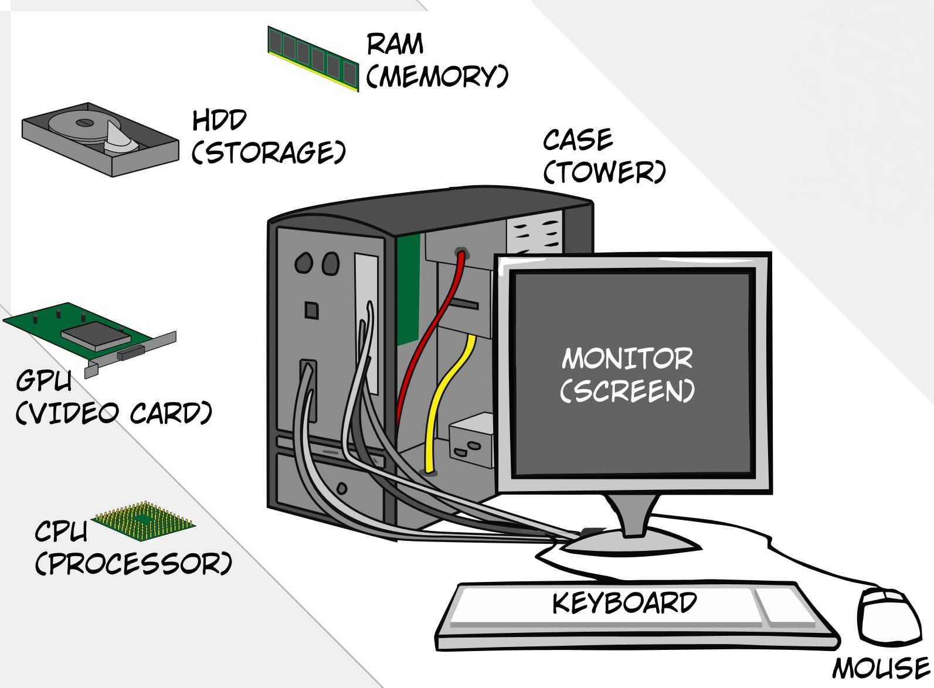
A Computer Model
An operating system has to deal with the fact that a computer is made up of a CPU, random access memory (RAM), input/output (I/O) devices, and long-term storage.

Slide 18
OS Concepts
An operating system (OS) provides the interface between the users of a computer and that computer’s hardware.
An operating system manages the ways applications access the resources in a computer, including its disk drives, CPU, main memory, input devices, output devices, and network interfaces.
An operating system manages multiple users.
Unique needs and rights of users/groups should be respected /malicious activities avoided
An operating system manages multiple programs.
Protecting each running app from interfering with each other/ avoid damaging of resources by malicious apps

Slide 19
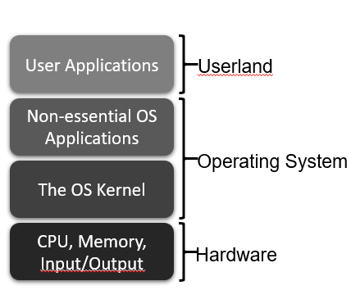
The Kernel
The kernel is the core component of the operating system.
It handles the management of low-level hardware resources, including memory, processors, and input/output (I/O) devices, such as a keyboard, mouse, or video display.
Most operating systems define the tasks associated with the kernel in terms of a layer metaphor, with the hardware components, such as the CPU, memory, and input/output devices being on the bottom, and users and applications being on the top.

Slide 20
Input/Output
The input/output devices of a computer include things like its keyboard, mouse, video display, and network card, as well as other more optional devices, like a scanner, Wi-Fi interface, video camera, USB ports, etc.
Each such device is represented in an operating system using a device driver, which encapsulates the details of how interaction with that device should be done.

Slide 21
System Calls
User applications don’t communicate directly with low-level hardware components, and instead delegate such tasks to the kernel via system calls.
System calls are usually contained in a collection of programs, that is, a library such as the C library (libc), and they provide an interface that allows applications to use a predefined series of APIs that define the functions for communicating with the kernel.
Examples of system calls include those for performing file I/O (open, close, read, write) and running application programs (exec).

Slide 22
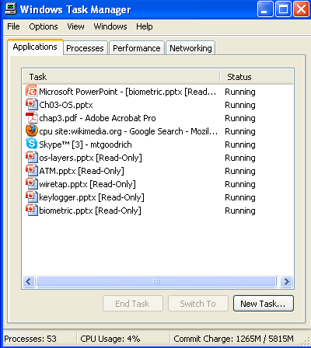
Processes
A process is an instance of a program that is currently executing.
The actual contents of all programs are initially stored in persistent storage, such as a hard drive.
In order to be executed, a program must be loaded into random-access memory (RAM) and uniquely identified as a process.
In this way, multiple copies of the same program can be run as different processes.
For example, we can have multiple copies of MS Powerpoint open at the same time.

Slide 23
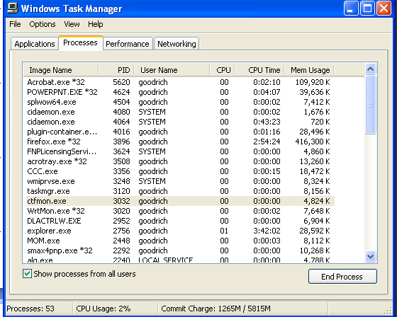
Process IDs
Each process running on a given computer is identified by a unique nonnegative integer, called the process ID (PID).
Given the PID for a process, we can then associate its CPU time, memory usage, user ID (UID), program name, etc.

Slide 24
Users and the Process Tree
If a user creates a new process by making a request to run some program,
The kernel sees this as an existing process asking to create a new process.
The process is called forking.
The existing process is the parent process and the one being forked is known as the child process.

Slide 25
Inter-process communication
Pass messages by reading and writing files
Share the same region of physical memory
Pipes and sockets: the sending and receiving processes to share the pipe or socket as an in-memory object.

Slide 26
Inter-process communication
Signals: in Unix-based system, processes can send direct messages to each other asynchronously.
Remote Procedure Calls: Windows rely on remote procedure calls (RPC) which allows a process to call a subroutine from another process’s program.

Slide 27
File Systems
A filesystem is an abstraction of how the external, nonvolatile memory of the computer is organized.
Operating systems typically organize files hierarchically into folders, also called directories.
Each folder may contain files and/or subfolders.
Thus, a volume, or drive, consists of a collection of nested folders that form a tree.
The topmost folder is the root of this tree and is also called the root folder.

Slide 28
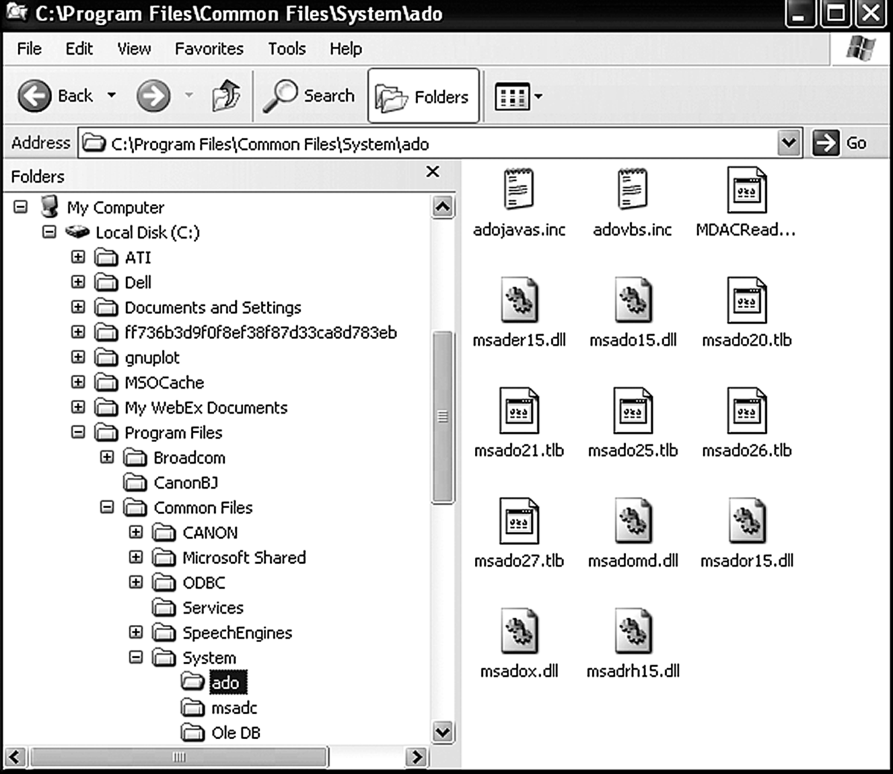
File System Example

Slide 29
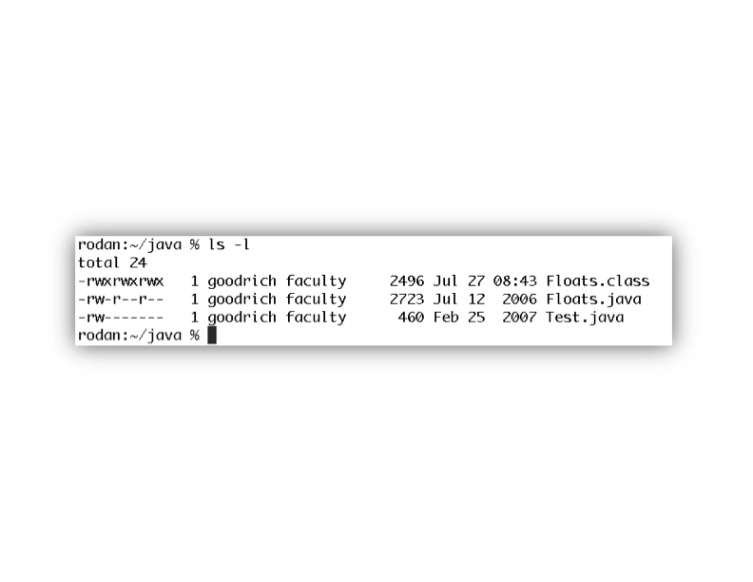
File Permissions
File permissions are checked by the operating system to determine if a file is readable, writable, or executable by a user or group of users.
In Unix-like OS’s, a file permission matrix shows who is allowed to do what to the file.
there is the owner class, which determines permissions for the creator of the ﬁle.
Next is the group class, which determines permissions for users in the same group as the ﬁle.
Finally, the others class determines permissions for users who are neither the owner of the ﬁle nor in the same group as the ﬁle.

Slide 30
Memory Management
The RAM memory of a computer is its address space.
It contains both the code for the running program, its input data, and its working memory.
For any running process, it is organized into different segments, which keep the different parts of the address space separate.
Security concerns require that we never mix up these different segments.

Slide 31
Memory Organization
Text. This segment contains the actual (binary) machine code of the program.
Data. This segment contains static program variables that have been initialized in the program code.
BSS. This segment, which is named for an antiquated acronym for block started by symbol, contains static variables that are uninitialized.
Heap. This segment, which is also known as the dynamic segment, stores data generated during the execution of a process.
Stack. This segment houses a stack data structure that grows downwards and is used for keeping track of the call structure of subroutines (e.g., methods in Java and functions in C) and their arguments.

Slide 32
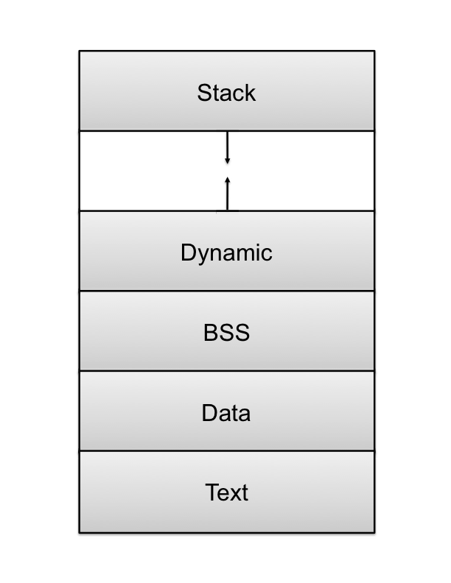
Memory Layout

Slide 33
Memory Access Permissions
Each of the ﬁve memory segments has its own set of access permissions (readable, writable, executable), and these permissions are enforced by the operating system.
The text region is usually read only,
It is generally not desirable to allow the alteration of a program’s code during its execution.
All other regions are writable, because their contents may be altered during a program’s execution. ,

Slide 34
Memory Access Permissions
An essential rule of operating systems security is that processes are not allowed to access the address space of other processes, unless they have explicitly requested to share some of that address space with each other.
Enforcing address space boundaries avoids many serious security problems by protecting processes from changes by other processes.

Slide 35
Memory Access Permissions
Operating systems divide the address space into two broad regions:
user space, where all user-level applications run, and
kernel space, which is a special area reserved for core operating system functionality.
Typically, the operating system reserves a set amount of space at the bottom of each process’s address space.

Slide 36
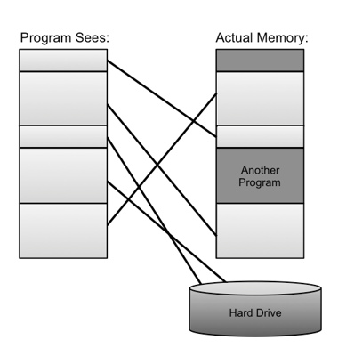
Virtual Memory
There is generally not enough computer memory for the address spaces of all running processes.
Nevertheless, the OS gives each running process the illusion that it has access to its complete (contiguous) address space.
In reality, this view is virtual, in that the OS supports this view, but it is not really how the memory is organized.
Instead, memory is divided into pages, and the OS keeps track of which ones are in memory and which ones are stored out to disk.
It allows for a computer to execute a set of processes that could not be multitasked if they all had to keep their entire address spaces in main memory all the time.

Slide 37
Page Faults
1. Process requests virtual address not in memory, causing a page fault.
2. Paging supervisor pages out
an old block of RAM memory.
“read 0110101”
“Page fault,
let me fix that.”
Process
Paging supervisor
old
Blocks in
RAM memory:
new
External disk
3. Paging supervisor locates requested block
on the disk and brings it into RAM memory.

Slide 38
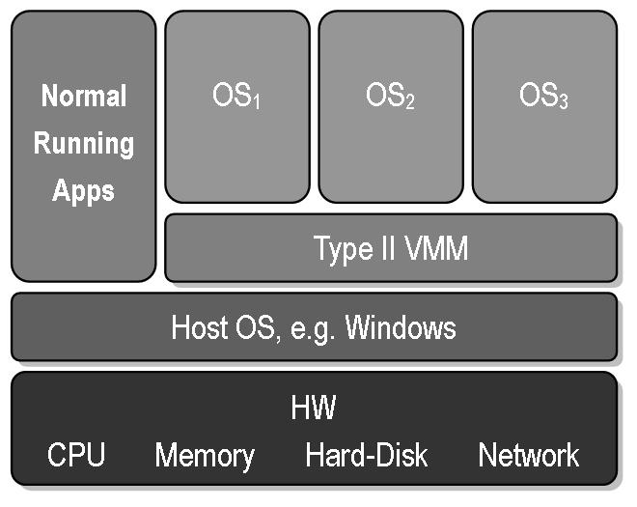
Virtual Machines
Virtual machine: A view that an OS presents that a process is running on a specific architecture and OS, when really it is something else. E.g., a windows emulator on a Mac.
Virtual machine technology allows an operating system to run without direct contact with its underlying hardware
Benefits:
Hardware Efficiency
Portability
Security
Management

Slide 39
Operating Systems Security

Slide 40
Process Security
To protect a computer, it is essential to monitor and protect the processes that are running on that computer
The protection of a computer and its processes should be maintained all the time, during booting, loading, running , sleeping/hibernating state etc.

Slide 41
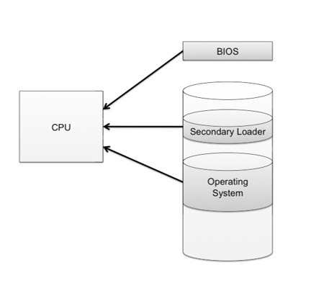
The Boot Sequence
The action of loading an operating system into memory from a powered-off state is known as booting or bootstrapping.
When a computer is turned on, it first executes code stored in a firmware component known as the BIOS (basic input/output system).
On modern systems, the BIOS identifies the system disk and loads into memory the second-stage boot loader (\bootmgr), which handles loading the rest of the operating system into memory and then passes control of execution to the operating system.

Slide 42
BIOS Passwords
A malicious user could potentially seize execution of a computer at several points in the boot process.
To prevent an attacker from initiating the first stages of booting, many computers feature a BIOS password that does not allow a second-stage boot loader to be executed without proper authentication.

Slide 43
Boot Device Hierarchy
There are some other security issues related to the boot sequence.
Most second-stage boot loaders allow the user to specify which device should be used to load the rest of the operating system.
In most cases, this option defaults to booting from the hard drive, or in the event of a new installation, from external media such as a DVD drive
one should make sure that the operating system is always booted from trusted media

Slide 44
Boot Device Hierarchy
There is a customizable hierarchy that determines the order of precedence of booting devices: the ﬁrst available device in the list is used for booting.
This ﬂexibility is important for installation and troubleshooting purposes, but it could allow an attacker with physical access to boot another OS from an external media- bypassing the security mechanisms built into the OS intended to run on the computer.
To prevent these attacks: second- stage boot loader password protection that only allow authorized users to boot from external storage media

Slide 45
Hibernation
Modern machines have the ability to go into a powered-off state known as hibernation.
While going into hibernation, the OS stores the contents of machine’s memory into a hibernation file (such as hiberfil.sys) on disk so that the state of the computer can be quickly restored when the system is powered back on.
But… without additional security precautions, hibernation exposes a machine to potentially invasive forensic investigation.
Since the entire contents of memory are stored into the hibernation ﬁle, any passwords or sensitive information that were stored in memory at the time of hibernation are preserved.
A live CD attack can be performed to gain access to the hibernation ﬁle.
Windows stores as C:\hiberﬁl.sys.
To defend against these attacks, hard disk encryption (BitLocker) should be applied.
Can this also happen when in a Sleep mode?

Slide 46
Monitoring, Management, and Logging
One of the most important aspects of operating systems security is something military people call “situational awareness.”
Keeping track of what processes are running, what other machines have interacted with the system via the Internet etc
For example, noticing log entries of repeated failed attempts to log in may warn of a brute-force attack, and prompt a system administrator to change passwords to ensure safety.

Slide 47
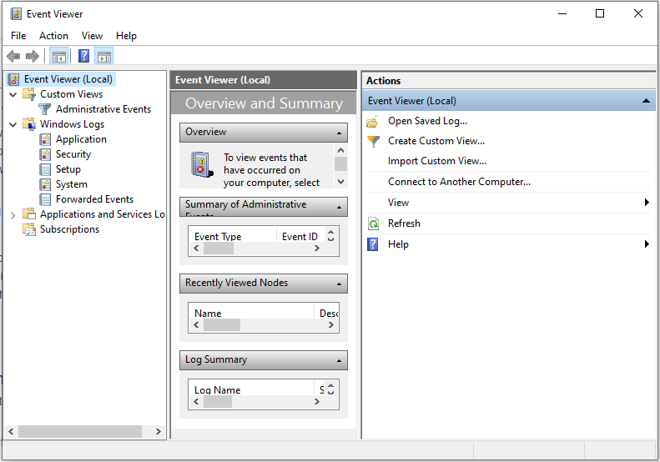
Event Logging
Operating systems therefore feature built-in systems for managing event logging.
Windows deﬁnes three possible sources of logs, “System,” “Application,” and “Security.”
The System log can only be written to by the operating system itself, while the Application log may be written to by ordinary applications.
Finally, the Security log can only be written to by a special Windows service known as the Local Security Authority Subsystem Service.

Slide 48
Process Monitoring
There are several scenarios where we would like to ﬁnd out exactly which processes are currently running on our computer.
For example, our computer might be sluggish and we want to identify an application using up lots of CPU cycles or memory.
Or we may suspect that our computer has been compromised by a virus and we want to check for suspicious processes.
Every operating system therefore provides tools that allow users to monitor and manage currently running processes.
Examples include the task manager application in Windows and the ps, top, pstree, and kill commands in Linux.

Slide 49
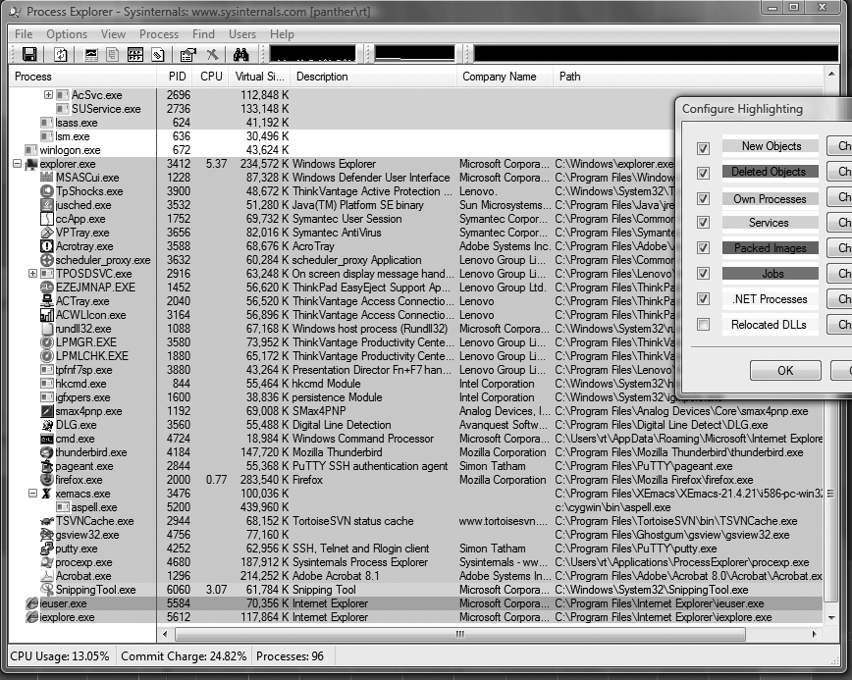
Process Explorer

Slide 50
Memory and Filesystem Security
The contents of a computer are encapsulated in its memory and filesystem.
Thus, protection of a computer’s content has to start with the protection of its memory and its filesystem.

Slide 51
Virtual Memory Security
virtual memory is a useful tool for operating systems.
It allows for multiple processes with a total address space larger than our RAM memory to run effectively,
It supports these multiple processes to each view its address spaces as being contiguous.

Slide 52
Virtual Memory Security
On Windows, virtual memory pages that have been written to the hard disk are actually contained in what is known as the page ﬁle, located at C:\pageﬁle.sys.
OSes enforce rules preventing users from viewing the contents of virtual memory ﬁles while the OS is running, and it may be conﬁgured such that they are deleted when the machine is shut down.

Slide 53
Attacks on Virtual Memory
However, if an attacker suddenly powered off the machine without properly shutting down and booted to another operating system via external media:
it may be possible to view these ﬁles and reconstruct portions of memory, potentially exposing sensitive information
Solution: hard disk encryption should be used in all cases where potentially untrusted parties have physical access to a machine

Slide 54
Securing users
How does the operating system securely identify its users?
A standard authentication mechanism used by most operating systems is:
→ for users to log in by entering a username and password

Slide 55
Password Security
The basic approach to guessing passwords from the password file is to conduct a dictionary attack, a method of breaking into a password-protected computer or server by systematically entering every word in a dictionary as a password.
A dictionary of 500,000 “words” is often enough to discover most passwords.

Slide 56

Password Salt
One way to make the dictionary attack more difficult to launch is to use salt.
Associate a random number with each userid.
Rather than comparing the hash of an entered password with a stored hash of a password, the system compares the hash of an entered password and the salt for the associated userid with a stored hash of the password and salt.

Slide 57
How Password Salt Works
Without salt:
1. User types userid, X, and password, P.
2. System looks up H, the stored hash of X’s password.
3. System tests whether h(P) = H.
Password file:
…
X: H
…
With salt:
1. User types userid, X, and password, P.
2. System looks up S and H, where S is the random salt for userid X and H is stored hash of S and X’s password.
3. System tests whether h(S||P) = H.
Password file:
…
X: S, H
…

Slide 58
How Salt Increases Search Space Size
Assuming that an attacker cannot find the salt associated with a userid he is trying to compromise, then the search space for a dictionary attack on a salted password is of size
2^{B}*D,
where B is the number of bits of the random salt and D is the size of the list of words for the dictionary attack.
For example, if a system uses a 32-bit salt for each userid and its users pick passwords in a 500,000 word dictionary, then the search space for attacking salted passwords would be
2³² * 500,000 = 2,147,483,648,000,000,
which is over 2 quadrillion.
Also, even if an attacker can find a salt password for a userid, he only learns one password.

Slide 59
Assignment – Physical Security and File System security
Authentication Technologies
Barcodes
Magnetic Stripe Cards
Smart Cards
SIM Cards
RFIDs
Biometrics
Direct Attacks Against Computers
Environmental Attacks and Accidents
Eavesdropping
TEMPEST
Live CDs
Computer Forensics
Cold Boot Attacks
Special-Purpose Machines
Physical Intrusion Detection
Physical Protections and Attacks
Locks and Safes
Lock Technology
Pin Tumbler Locks
Tubular and Radial Locks
Wafer Tumbler Locks
Combination Locks
Master and Control Keys
Attacks on Locks and Safes
Lockpicking
Lock Bumping
Key Duplication and Impressioning
Safe Cracking
Side Channel Attacks

Slide 60
Filesystem Security
Access Control
Advanced File Permissions
File Descriptors
Symbolic Links
Shortcuts

Slide 61
Filesystem Security

Slide 62
General Principles
Files and folders are managed by the operating system
Applications access files through an API
Access control entry (ACE)
Allow/deny a certain type of access to a file/folder by user/group
Access control list (ACL)
Collection of ACEs for a file/folder

Slide 63
Access Control Entries and Lists
An Access Control List (ACL) for a resource (e.g., a file or folder) is a sorted list of zero or more Access Control Entries (ACEs)
An ACE specifies that a certain set of accesses (e.g., read, execute and write) to the resources is allowed or denied for a user or group
Examples of ACEs for folder “Bob’s CS167 Grades”
Bob; Read; Allow
TAs; Read; Allow
TWD; Read, Write; Allow
Bob; Write; Deny
TAs; Write; Allow

Slide 64
Linux vs. Windows
Linux
Allow-only ACEs
Access to file depends on ACL of file and of all its ancestor folders
Start at root of file system
Traverse path of folders
Each folder must have execute (cd) permission
Different paths to same file not equivalent
Windows
Allow and deny ACEs
Access to file depends only on file’s ACL
ACLs of ancestors ignored when access is requested
Permissions set on a folder usually propagated to descendants (inheritance)
System keeps track of inherited ACE’s

Slide 65
Discretionary Access Control (DAC)
Users can protect what they own
The owner may grant access to others
The owner may define the type of access (read/write/execute) given to others
DAC is the standard model used in operating systems
A file handle provides an identifier for a file/folder
File operations
Open file: returns file handle
Read/write/execute file
Close file: invalidates file handle

Slide 66
Closed vs. Open Policy
Closed policy
Also called “default secure”
Give Tom read access to “foo”
Give Bob r/w access to “bar”
Tom: I would like to read “foo”
Access allowed
Tom: I would like to read “bar”
Access denied
Open Policy
Deny Tom read access to “foo”
Deny Bob r/w access to “bar”
Tom: I would like to read “foo”
Access denied
Tom: I would like to read “bar”
Access allowed

Slide 67
Unix Permissions
Standard for all UNIXes
Every file is owned by a user and has an associated group
Permissions often displayed in compact 10-character notation
To see permissions, use ls –l
jk@sphere:~/test$ ls –l
total 2
-rw-r----- 1 jk ugrad 0 2005-10-13 07:18 file1
-rwxrwxrwx 1 jk ugrad 0 2005-10-13 07:18 file2

Slide 68
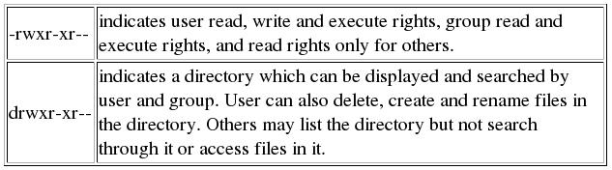
File Permission Examples

Slide 69
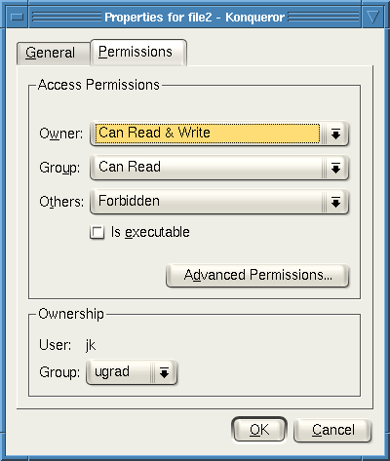
Working Graphically with Permissions
Several Linux GUIs exist for displaying and changing permissions
Right-click on a file and choose Properties, and click on the Permissions tab:
Changes can be made here

Slide 70
Sharing data on a multiuser system
Giving write access on your own directory isn't a safe way to share data.
This gives the ability to do anything (accidently or deliberately) to any of the contents of the directory.
If you want to share your files, allocate read and execute permission to the directory and read permission to your files.
Others can then read them or copy them into their own directories.

Slide 71
Root
“root” account is a super-user account, like Administrator on Windows
Multiple roots possible
File permissions do not restrict root
This is dangerous, but necessary, and OK with good practices

Slide 72
File Descriptors
In order for processes to work with files, they need a shorthand way to refer to those files.
other than always going to the filesystem and specifying a path to the files in question
In order to efficiently read and write files stored on disk, modern operating systems rely on a mechanism known as file descriptors.
When a program needs to access a file, a call is made to the open system call, which results in the kernel creating a new entry in the file descriptor table which maps to the file’s location on the disk
when finished, the program should issue the close system call to remove the open file descriptor

Slide 73
File Descriptor Leaks
A common programming error that can lead to serious security - a file descriptor leak
A dangerous scenario can arise when a program with high privileges:
opens a file descriptor to a protected file (ex. Password)
fails to close it, and then
creates a process with lower permissions.
Since the new process inherits the file descriptors of its parent,
it will be able to read or write to the file
although the child process might not have permission to open that file in other circumstances.

Slide 74
Symbolic Links and Shortcuts
It is often useful for users to be able to create links or shortcuts to other files on the system, without copying the entire file to a new location
To the user, symlinks appear to reside on the disk like any other file
but they simply point to another file or folder on disk.
Symlinks can often provide a means by which malicious parties can trick applications into performing undesired behavior

Slide 75
Symbolic Links and Shortcuts
Suppose that this program is designed specifically to prohibit the reading of one particular file, say, /home/admin/passwords.
An unsafe version of this program would simply check that the filename specified by the user is not /home/admin/passwords.
However, an attacker could trick this program by creating a symlink to the passwords file and specifying the path of the symlink instead.
How do you solve it? Is this attack common in Windows OSs?

Slide 76
Application Program Security
Many attacks don’t directly exploit weaknesses in the OS kernel, but rather attack insecure programs.
These programs, operating at the applications layer could include program to change passwords, which runs with higher privileges than those granted to common users.
So these programs should be protected against privilege escalation attacks.

Slide 77
Simple Buffer Overflow Attacks
In any situation where a program allocates a fixed-size buffer in memory in which to store information
Care must be taken to ensure that copying user-supplied data to this buffer is done securely and with boundary checks.
If this is not the case, then it may be possible for an attacker to provide input that exceeds the length of the buffer,
which the program will then attempt to copy to the allotted buffer.
This copying may overwrite data beyond the location of the buffer in memory
Potentially allow the attacker to gain control of the entire process and execute arbitrary code on the machine

Slide 78
Arithmetic Overflow
The overflow condition is a limitation having to do with the representation of integers in memory.
In most 32-bit architectures, signed integers are expressed in what is known as two’s compliment notation.
In hex notation, signed integers 0x00000000 to 0x7ffffff are positive numbers,
and 0x80000000 to 0xffffffff are negative numbers.
For example, if a program continually adds very large numbers and eventually exceeds the maximum value for a signed integer, 0x7fffffff, the representation of the sum overflows and becomes negative rather than positive

Slide 79
An Example Vulnerability
Suppose a network service keeps track of the number of connections it has received since it has started, and only grants access to the first five users.
An unsafe implementation can be as below:

Slide 80
#include <stdio.h>
int main(int argc, char * argv[ ])
{
unsigned int connections = 0;
// Insert network code here
// . . .
// . . .
// Does nothing to check overflow conditions
connections++;
if(connections < 5)
grant access();
else deny access();
return 1;
}

Slide 81
Stack-based BoF (cond)
Read about other BoF attacks and how to secure these vulnerabilities

Slide 82
Malware: Malicious Software

Slide 83
Malicious Software / Malware
This chapter is devoted to the ways that software systems can be attacked by malicious software, which is also known as malware.
Malicious software is software whose existence or execution has negative and unintended consequences.
We discuss various kinds of malware, including some case studies, and how systems and networks can be protected from malware

Slide 84
Viruses, Worms, Trojans, Rootkits
Malware can be classified into several categories, depending on propagation and concealment
Propagation
Virus: human-assisted propagation (e.g., open email attachment)
Worm: automatic propagation without human assistance
Concealment
Rootkit: modifies operating system to hide its existence
Trojan: provides desirable functionality but hides malicious operation
Various types of payloads, ranging from annoyance to crime

Slide 85
4.1 Insider Attacks
An insider attack is a security breach that is caused or facilitated by:
someone who is a part of the very organization that controls or builds the asset that should be protected.
In the case of malware:
an insider attack refers to a security hole that is created in a software system by one of its programmers.

Slide 86
4.1.1 Backdoors
A backdoor, which is also sometimes called a trapdoor,:
is a hidden feature or command in a program that allows a user to perform actions he or she would not normally be allowed to do.
When used in a normal way, the program performs completely as expected and advertised.
But if the hidden feature is activated, the program does something unexpected, often in violation of security policies, such as performing a privilege escalation.
Benign example: Easter Eggs in software and games

Slide 87
4.1.1 Backdoors inserted for debugging purpose
A programmer is working on an elaborate biometric authentication system for a computer login program.
She may wish to provide a special command or password that can bypass the biometric system in the event of a failure.
It is useful during the code development and debugging but become a risk that may allow an attacker to bypass authentication measures.

Slide 88
4.1.1 Deliberate Backdoors
Deliberately insert backdoors so programmers can perform malicious actions later.
For example, a program may add a backdoor using of a sequence of keystrokes to access a digital entry system for a bank vault.
Deliberately introduce a vulnerability to a program such as BoF.
Introducing an exploitable bug into the code of an open source project, allow programmers to gain access from other machines.

Slide 89
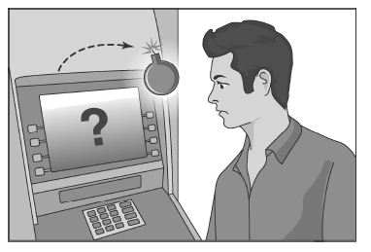
4.1.2 Logic Bombs
A logic bomb is a program that performs a malicious action as a result of a certain logic condition.
The classic example of a logic bomb is a programmer coding up the software for the payroll system who puts in code that makes the program crash should it ever process two consecutive payrolls without paying him.
Another classic example combines a logic bomb with a backdoor, where a programmer puts in a logic bomb that will crash the program on a certain date.

Slide 90
4.1.2 The Omega Engineering Logic Bomb
An example of a logic bomb that was actually triggered and caused damage is one that programmer Tim Lloyd was convicted of using on his former employer, Omega Engineering Corporation.
On July 31, 1996, a logic bomb was triggered on the server for Omega Engineering’s manufacturing operations, which ultimately cost the company millions of dollars in damages and led to it laying off many of its employees.

Slide 91
4.1.2 The Omega Bomb Code
The Logic Behind the Omega Engineering Time Bomb included the following strings:
7/30/96
Date that triggered the bomb; time bomb
F:
Focused attention to volume F, which had critical files
F:\LOGIN\LOGIN 12345
Login a fictitious user, 12345 (the back door). The user had supervisory and destroy permissions but no password.
CD \PUBLIC
Change the current directory to the public folder
FIX.EXE /Y F:\*.*
Run a program, called FIX, which actually deletes everything; /Y means each file should be deleted. F:\ *.* deletes all files.
PURGE F:\/ALL
Prevent recovery of the deleted files

Slide 92
4.1.3 Defenses against Insider Attacks
Avoid single points of failure.
Use code walk-throughs.
Use archiving and reporting tools.
Limit authority and permissions.
Physically secure critical systems.
Monitor employee behavior.
Control software installations.

Slide 93
4.2 Computer Viruses
A computer virus is computer code that can replicate itself by modifying other files or programs to insert code that is capable of further replication.
This self-replication property is what distinguishes computer viruses from other kinds of malware, such as logic bombs.
Another distinguishing property of a virus is that replication requires some type of user assistance, such as clicking on an email attachment or sharing a USB drive.

Slide 94
Virus Phases
Dormant phase. During this phase, the virus just exists—the virus is laying low and avoiding detection.
Propagation phase. During this phase, the virus is replicating itself, infecting new files on new systems.
Triggering phase. In this phase, some logical condition causes the virus to move from a propagation phase to perform its intended action.
Action phase. In this phase, the virus performs the malicious action that it was designed to perform, called payload.
This action could include something seemingly innocent, like displaying a silly picture on a computer’s screen, or something quite malicious, such as deleting all essential files on the hard drive.

Slide 95
Types of Viruses
Program Virus / file virus:
infects a program by modifying the file containing its object code.
Once the infection occurs, a program virus is sure to be run each time the infected program executes.
Macro virus / document virus
When a document is opened, it searches for other documents to infect.
It can insert itself into the document template, which makes the newly created document infected.
Further propagation occurs when the infected documents are emailed to other users.
Boot section virus:
Infects the code in the boot sector of a drive, which is run each time the computer is turned on or restarted.

Slide 96
4.2.2 Defences against viruses - Signature
Scan and compare the analyzed object with a database of signatures
A signature is a virus fingerprint
E.g., a string with a sequence of instructions specific for each virus
A file is infected if there is a signature inside its code
Fast pattern matching techniques to search for signatures
All the signatures together create the malware database that usually is proprietary
Common Malware Enumeration (CME)
Digital Immune System (DIS)

Slide 97
4.2.2 Defences against viruses -- Quarantine
A suspicious file can be isolated in a folder called quarantine:
The suspicious file is not deleted but made harmless: the user can decide when to remove it or eventually restore for a false positive
Interacting with a file in quarantine is possible only through the antivirus program
The file in quarantine is harmless because it is encrypted
Usually the quarantine technique is proprietary and the details are kept secret

Slide 98
4.2.3 Encrypted Viruses
The presence of their virus in a file is more stealthy if the main body of the program is encrypted, especially the replication code and payload
The virus code’s new structure: the decryption key, the key and the encrypted virus code.
This structure becomes a kind of virus signature
The arm race continues: Signature based detection → encrypted viruses → look for encryption code

Slide 99
4.2.4 Polymorphic and Metamorphic Viruses
Another technique used by viruses to ﬁght back against signature-based detection is mutating as they replicate, thereby creating many different varieties of the same virus
Polymorphic virus
Using encryption.
Each copy of the virus is encrypted using a different key.
Detect by generic code for an encryption algorithm
Metamorphic virus
Non-cryptographic obfuscation techniques, such as instruction reordering, inclusion of useless instructions.
Challenging to detect

Slide 100
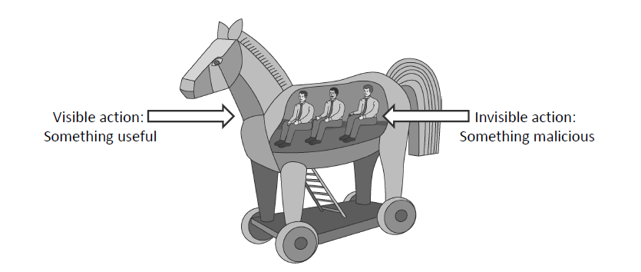
4.3 Malware Attacks -- Trojan Horses
A Trojan horse (or Trojan) is a malware program that appears to perform some useful task, but which also does something with negative consequences (e.g., launches a keylogger).
Trojan horses can be installed as part of the payload of other malware but are often installed by a user or administrator, either deliberately or accidentally.

Slide 101
4.3 Malware Attacks -- Trojan Horses
The AIDS Trojan
It was ﬁrst distributed by mailing ﬂoppy disks in 1989
it would encrypt the user’s hard drive, Then the Trojan would offer to give the user the password to decrypt the hard drive, but only after she paid a fee. (similar to ransomeware)
Mocmex
it was discovered that several Chinese made digital photo frames
malware is copied from the frame to the computer and begins collecting and transmitting passwords

Slide 102
4.3 Malware Attacks -- Computer Worms
A computer worm is a malware program that spreads copies of itself without the need to inject itself in other programs, and usually without human interaction.
Thus, computer worms are technically not computer viruses (since they don’t infect other programs), but some people nevertheless confuse the terms, since both spread by self-replication.
In most cases, a computer worm will carry a malicious payload, such as deleting files or installing a backdoor.

Slide 103
Worm Development
Typically spread by exploiting vulnerabilities (e.g. BoF) in application run by Internet-connected computer systems that have a security hole.
A worm then propagates by having each infected computer attempt to infect other target machines by connecting to them over the Internet.
If a target machine is also vulnerable to this attack, then it will be infected and will try to infect some other machines in turn

Slide 104
Worm Development
Once a system is infected, a worm must take steps to ensure that it persists on the victim machine and survives rebooting.
On Windows machines, this is commonly achieved by modifying the Windows Registry, a database used by the operating system that includes entries that tell the operating system to run certain programs and services or load device drivers on startup.
One of the most common registry entries for this purpose is called
HKEY LOCAL MACHINE \SOFTWARE \Microsoft \Windows \CurrentVersion \Run
Associating with this entry the path to the executable ﬁle of the worm will result in Windows executing the worm on startup.
Thus, malware detection software always checks this entry (and other registry entries specifying programs to run at startup) for suspicious executable names.

Slide 105


Worm Propagation
Worms propagate by finding and infecting vulnerable hosts.
They need a way to tell if a host is vulnerable
They need a way to tell if a host is already infected.
initial infection

Slide 106
Real world worms
ILOVEYOU. This is an email worm (a worm sent as an email attachment) ﬁrst observed in 2000.
LOVE-LETTER-FORYOU.TXT.vbs.
When executed on a computer running Microsoft Windows, sends itself to everyone in the user’s address book and then replaces documents and pictures on the user’s hard drive with copies of itself.

Slide 107
Real world worms
Blaster. This is a computer worm that exploited a previous buffer over ﬂow vulnerability in computers running Microsoft Windows XP and Windows 2000 in 2003.
It spread by sending copies of itself to random computers on the Internet, hoping to ﬁnd other machines with the buffer-overﬂow vulnerability.
Its payload was designed to launch a denial-of-service attack against Microsoft’s update web site.

Slide 108
Detecting worms
The detection of worms can be performed with signature-based ﬁle scanning techniques similar to those described for viruses.
In addition, network-level scanning and ﬁltering, which consists of analyzing the content of network packets before they are delivered to a machine, allows to detect and block worms in real time.

Slide 109
4.3.3 Rootkits
A rootkit is an especially stealthy type of malware.
A rootkit alter system utilities or the OS itself to prevent detection
Infect Windows process monitor utility, which list current running processes
Infect utilities that allow the user to browse files, such as Windows Explore to hide files on disk
Rootkits are often used to hide the malicious actions of other types of malware such as Trojan Horse
User-mode rootkits
Alter system utilities or libraries on disk
Insert code to another user-mode process’s address space to alter its behavior, such as DLL injection
Kernel mode rootkits
Loaded as device drivers which allows user to easily install drivers for keyboard, audio or video devices.
Function hooking to achieve stealth. Modify kernel memory to replace OS functions with customized versions.

Slide 110
4.3.3 Rootkits
Detecting Rootkit
Two scans of file system (counting files)
High-level scan using the Windows API
Raw scan using disk access methods
Discrepancy reveals presence of rootkit
Could be defeated by rootkit that intercepts and modifies results of raw scan operations

Slide 111
4.3.4 Zero-day attacks
A zero-day attack is an attack that exploits a vulnerability that was previously unknown, even to the software designers who create the system containing this vulnerability.
Which means a malware attack exploits a vulnerability that the developers did not know about.

Slide 112
4.3.4 Zero-day attacks -- Heuristic Analysis
Useful to identify new and “zero day” malware
Code analysis
Based on the instructions, the antivirus can determine whether or not the program is malicious, i.e., program contains instruction to delete system files,
Execution emulation
Run code in isolated emulation environment
Monitor actions that target file takes
If the actions are harmful, mark as virus
Heuristic methods can trigger false alarms

Slide 113
4.3.5 Bontnets
Malware can turn a computer in to a zombie, which is a machine that is controlled externally to perform malicious attacks, usually as a part of a botnet.
Botnet Controller (Attacker)
Attack Commands
Botnet:
Attack Actions
Victim

Slide 114
Questions?

